Slide 1
Database System (CS-103)
Data Definition Language with Constraints
Mr. Hamza Javed,
Department of Computer Science,
Muslim Youth University, Islamabad, Pakistan

Slide 2

DBMS & SQL
Notes:
DBMS use Sql language to management databases

Slide 3

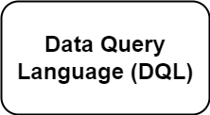
SQL Commands
SQL contain a lot of commands.
Due to different commands and result generated by them. Its divided into four components.
Notes:
DCL : Grant & Revoke TCL : commit, Rollback & savepoint

Slide 4

Data Definition Language(DDL)

Slide 5
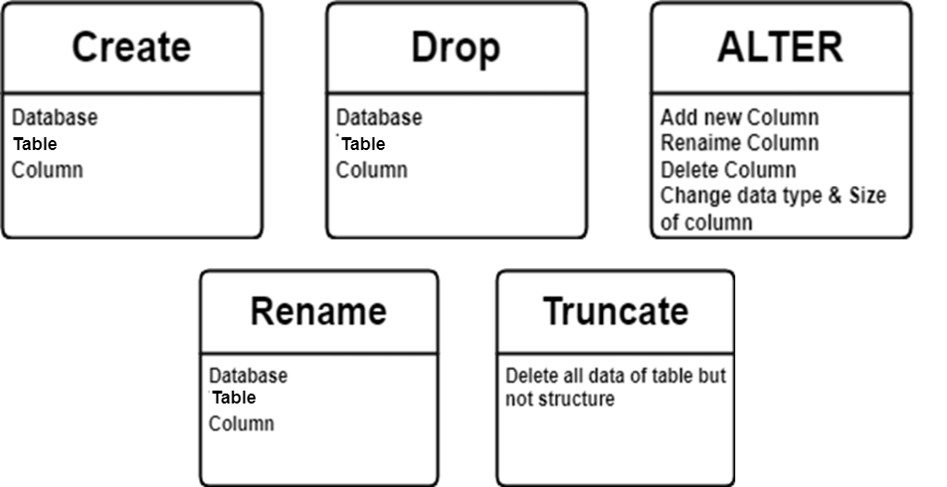
Commands in DDL

Slide 6
DDL - Create Database
Syntax:
dbname;
Keywords
Example:
CREATE DATABASE dblab;
CREATE DATABASE

Slide 7
DDL - Create Table
Syntax:
create table tablename(column-1 Datatype(length), column-2 Datatype(length), column-3 Datatype(length)) ;
Example:
create table dblab.info(id int, name varchar(255), phone varchar(255), email varchar(255), image_name varchar(255), image_data longblob);

Slide 8
DML- Insert data
Syntax:
Insert into table(column1, column2, column3……… ) values(data1, data2, data3………);
Example:
insert into dblab.detail(id, name, phone, city, email, image_name, image_data) values('3', 'Ahmed', '123456', 'Islamabad', 'pak@myu.edu.pk', 'myulogo', load_file('C:\\ProgramData\\MySQL\\MySQL Server 8.0\\Uploads\\logo.png’));

Slide 9
DQL- Select data
Syntax:
SELECT * FROM tablename;
Example:
SELECT * FROM dblab.info;
OR
show columns in dblab.info;

Slide 10
DDL- Alter(add new column)
Syntax:
alter table tablename Add new column datatype(size);
Example:
alter table dblab.info Add country varchar(255);

Slide 11
DDL- Alter(add column after specific column)
Syntax:
alter table tablename Add new column datatype(size) after column name;
Example:
alter table dblab.info Add city varchar(255) after phone;

Slide 12
DDL- Alter(change column name)
Syntax:
alter table tablename change column new column datatype(size);
Example:
alter table dblab.info change phone contact varchar(255);

Slide 13
DDL- Alter(change column size)
Syntax:
alter table tablename change column column datatype(size);
Example:
alter table dblab.info change phone phone int;

Slide 14
DDL- Alter(remove column)
Syntax:
alter table tablename drop column name;
Example:
alter table dblab.info drop country;

Slide 15
DDL- Rename(change table name)
Syntax:
rename table tablename to new tablename;
Example:
rename table dblab.info to dblab.detail;

Slide 16
DDL- Truncate(remove table record)
Syntax:
truncate table tablename;
Example:
truncate table dblab.detail;

Slide 17
Query
-- truncate table dblab.detail;
-- rename table dblab.info to dblab.detail;
-- alter table dblab.info drop country;
-- show columns in dblab.info;
-- alter table dblab.info change phone phone int;
-- alter table dblab.info change phone contact varchar(255);
-- alter table dblab.info Add country varchar(255);
-- alter table dblab.info Add city varchar(255) after phone;
-- create table dblab.info(id int, name varchar(255), phone varchar(255), email varchar(255), image_name varchar(255), image_data longblob);
-- SELECT * FROM dblab.info;
-- Drop table dblab.info;
-- SELECT * FROM dblab.info;
-- show columns in dblab.info;
-- insert into dblab.detail(id, name, phone, city, email, image_name, image_data) values('3', 'Ahmed', '123456', 'Islamabad', 'pak@myu.edu.pk', 'myulogo', load_file('C:\\ProgramData\\MySQL\\MySQL Server 8.0\\Uploads\\logo.png’));
-- create table dblab.info(id int, name varchar(255), phone varchar(255), email varchar(255), image_name varchar(255), image_data longblob);
-- create database dblab;
-- Drop database student;

Slide 18
Constraint
Not Null
Unique
Default
Check
Primary Key
Foreign Key

Slide 19
Constraint
Id | Name | Age | Gender | Phone | University
1 | Ali | 17 | Male | 0123456 | Muslim Youth
2 | Arslan | 19 |  | 6534345 | Muslim Youth
 | Faizan | 20 | Male | 0123456 | Muslim youth
4 | Zara | 22 | Female | 6765643 | Muslim Youth

Slide 20
Constraint
Id | Name | Age | Gender | Phone | University
1 | Ali | 17 | Male | 0123456 | Muslim Youth
2 | Arslan | 19 |  | 6534345 | Muslim Youth
 | Faizan | 20 | Male | 0123456 | Muslim youth
4 | Zara | 22 | Female | 6765643 | Muslim Youth

Slide 21
Constraint
Id | Name | Age | Gender | Phone | University
1 | Ali | 17 | Male | 0123456 | Muslim Youth
2 | Arslan | 19 |  | 6534345 | Muslim Youth
 | Faizan | 20 | Male | 0123456 | Muslim youth
4 | Zara | 22 | Female | 6765643 | Muslim Youth
Not Null
Unique
Check
Not Null
Unique
Default

Slide 22
Constraint (syntax)
Create table tablename(
column1 datatype (size) constraint,
column2 datatype (size) constraint,
column3 datatype (size) constraint,
);

Slide 23
Constraint (Query)
Create table student(
Id int Not Null UNIQUE,
Name varchar(255) Not Null,
Age int Not Null check(age>=18),
Gender varchar(50) Not Null,
Phone int Not Null UNIQUE,
City varchar(50) Not Null Default 'Muslim Youth'
);
Notes:
insert into sectionb.student(id, S_Name, Age, Gender, phone) value (1, 'Fakhar', 18, 'male', 0123466);

Slide 24
Constraint (Primary key - syntax)
Create table tablename(
column1 datatype (size) constraint,
column2 datatype (size) constraint,
column3 datatype (size) constraint,
Primary key (id)
);

Slide 25
Constraint (Primary key Query for new table)
Create table student.personal1(
Id int Not Null Auto Increment,
Name varchar(255) NotNull,
Age int Not Null check(age>=18),
Gender varchar(50) Not Null,
Phone int Not Null UNIQUE,
City varchar(50) Not Null Default ‘Muslim Youth’,
Primary Key(id)
);
Notes:
insert into student.personal(id, Name, Age, Gender, Phone, City) values('2', 'Ali', '18', 'male', '0003456', "MUslim Youth");

Slide 26
Constraint (Primary key syntax for existing table)
Alter table tablename Add Primary key(id);

Slide 27
Constraint (Primary key Query for existing table)
Alter table tablename Add Primary key(id);
Notes:
insert into student.personal(id, Name, Age, Gender, Phone, City) values('2', 'Ali', '18', 'male', '0003456', "MUslim Youth");

Slide 28
Constraint (Super key - syntax)
Create table tablename(
column1 datatype (size) constraint,
column2 datatype (size) constraint,
column3 datatype (size) constraint,
CONSTRAINT constraint_name PRIMARY KEY (column1, column2)
);

Slide 29
Constraint (Super key Query for new table)
CREATE TABLE sectionb.student3(
id INT,
Name VARCHAR(255),
Age INT,
Gender VARCHAR(10),
Phone VARCHAR(15),
City VARCHAR(255),
CONSTRAINT super_key PRIMARY KEY (id, Name, Phone)
);
Notes:
INSERT INTO sectionb.student3 (id, Name, Age, Gender, Phone, City)VALUES (1, 'John Doe', 30, 'Male', '1234567890', 'New York'),(2, 'Jane Smith', 25, 'Female', '9876543210', 'Los Angeles'),(3, 'Alice Johnson', 40, 'Female', '1234568890', 'Chicago');

Slide 30
Constraint (Foreign key)
Id | Name | Age | University
1 | Ali | 17 | Muslim Youth
2 | Arslan | 19 | FAST-NUCES
3 | Faizan | 20 | Air University
4 | Zara | 22 | Islamic university
UId | University
11 | Muslim Youth
12 | FAST-NUCES
13 | Air University
14 | Islamic university

Slide 31
Constraint (Foreign key)
Id | Name | Age | University
1 | Ali | 17 | 11
2 | Arslan | 19 | 12
3 | Faizan | 20 | 13
4 | Zara | 22 | 14
UId | University
11 | Muslim Youth
12 | FAST-NUCES
13 | Air University
14 | Islamic university
Primary Key
Primary Key
Foreign Key

Slide 32
Constraint (Foreign key - syntax)
Create table tablename(
column1 datatype (size) constraint,
column2 datatype (size) constraint,
column3 datatype (size) constraint,
Primary key (id)
Foreign key (university) references (uid);
);

Slide 33
Constraint (Foreign key Query for new table)
Create table univers(
UId int Not Null Auto_increment,
UName varchar(255) Not Null,
Primary Key(UId)
);
Create table student (
Id int Not Null Auto_increment,
Name varchar(255) Not Null,
Age int Not Null check(age>=18),
Gender varchar(50) Not Null,
Phone int Not Null UNIQUE,
UName int Not Null,
Primary Key(id),
Foreign key (UName) references sectionb.univers(UId)
);
Notes:
INSERT INTO sectionb.univers(UName) VALUES ('University A'), ('University B'), ('University C’);
INSERT INTO sectionb.student4(Name, Age, Gender, Phone, UName) VALUES ('John Doe', 20, 'Male', 7890, 1), ('Jane Smith', 22, 'Female', 98765, 4), ('Alice Johnson', 25, 'Female', 5551, 3);

Slide 34
Data Type
Int, BINT & SMALLINT
Date, Time & DateTime
Float
Varchar or char
update sectionb.student4 Set Age = 44 where Id = 7;

Slide 35
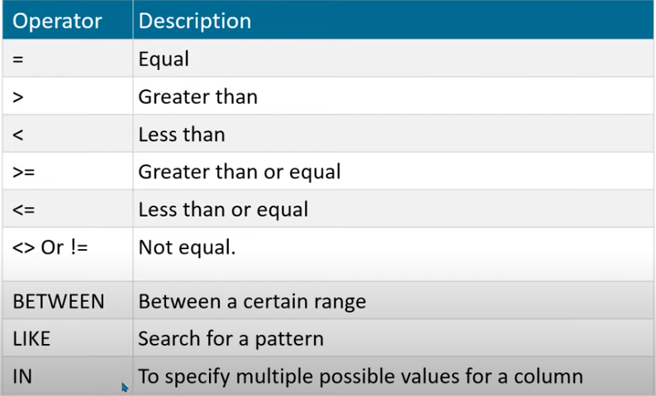
DQL(Data Query Language)

Slide 36
DQL(Data Query Language)
AS:
SELECT Name AS Student_Name, Phone FROM sectionb.student4 WHERE NOT Age = 44;
Other queries
Select column_name, column_name from table
Select * from table where column_name = value;
Select column_name, column_name from table where column_name = value;

Slide 37
DQL(Data Query Language)
AND
OR
NOT
SELECT Name, Phone FROM student4 WHERE Age <= 44 OR Gender = 'Male’;
SELECT Name, Phone FROM sectionb.student4 WHERE NOT Age = 44;

Slide 38
DML(Data Manipulation Language)
Update table Set column_name = value where column_name = value
update sectionb.student4 Set Age = 44 where Id = 7;

Slide 39
DML(Data Manipulation Language)
Delete * from table
Delete from table where column_name = value
Delete from student where Id = 7;

